Slide 1

Industry's Role in Promoting Best Practices
A Collaborative Approach to Food Safety
Global Food Safety Policy Forum
Washington DC
September 16, 2011
Shannon Cole, MS, PMP
Senior Director, Science Program Management
GMA
www.gmaonline.org

Slide 2
What is the Grocery Manufacturers Association?
GMA represents the world’s leading food, beverage and consumer product companies involved in global sourcing
GMA provides leadership to the industry in food safety through promotion of scientific excellence
  State of art research and analytical laboratory
  Training in regulatory and food safety issues
  Collaboration with U.S. government on food issues
  GMA is a founding member of the APEC FSCF PTIN Steering Group

Slide 3
Why is industry here?
GMA companies recognize…
A critical need to restore and maintain consumer trust in food safety and brand protection
Capacity building is critical and governments do not have the resources to do it alone.
Food companies must increase vigilance both domestically and overseas (supply chain management)
Industry has resources to offer:
  Scientific and technical expertise
  An understanding of international best practices and trade
  Multinational presence
  Relationships with suppliers

Slide 4
Collaborations Will Enhance Food Safety
Industry, government & academia must work together to enhance food safety
Government
Industry
Safe Food
Academia

Slide 5
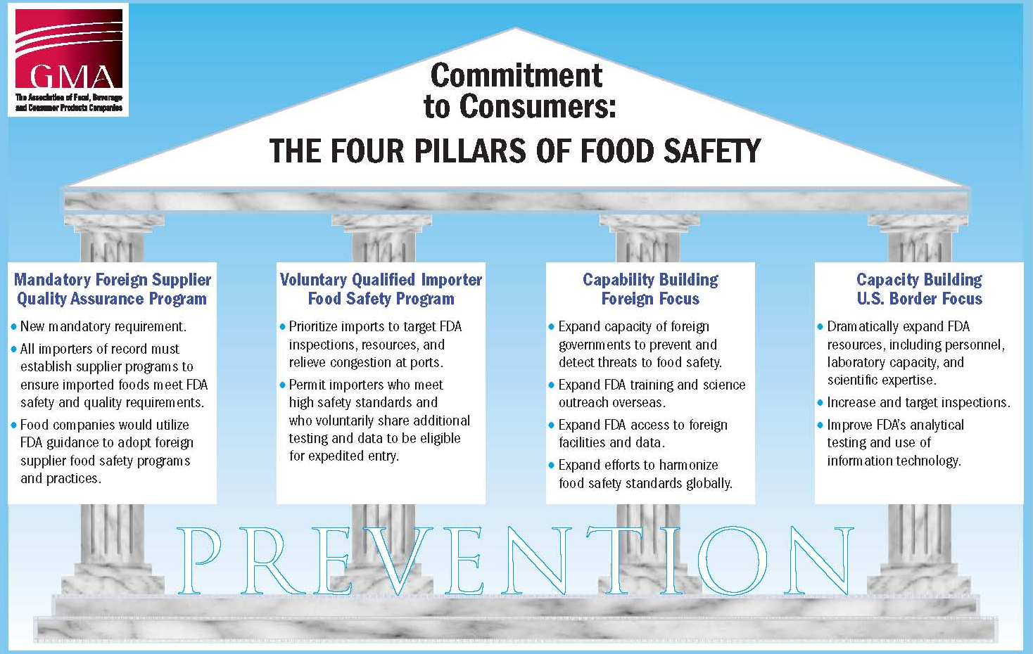
Capacity Building
Mandatory Foreign Supplier Quality Assurance Program
Voluntary Qualified Importer Food Safety Program
Capability Building Foreign Focus
Capability Building US Border Focus
Notes:
Remind all about the history of the 4 pillars of food safety
Who developed them
When were they developed
How have they been used

Slide 6
Key Elements of The Four Pillars
Best In Class: Many companies currently have “best in class” foreign supplier food safety programs in place
Farm to Fork: Under the Four Pillars proposal, every food manufacturer must meet best in class standards and apply those standards across the entire supply chain
Private-Public Partnership: Strengthening the private-public food safety partnership is critical to restoring consumer confidence

Slide 7
Challenges FDA is going to face with FSMA Implementation
Funding
  How is FDA going to pay for the new requirements within FSMA?
Enforcement and compliance
  How is FDA going to effectively be able to enforce the 50 new rules?
Inspections
  How is FDA going to be able to go from 600 inspections in 2011 to 9600 in 2015
Capacity building
  How is FDA going to be able to build the capacity of foreign governments and inspectors on FSMA requirements?

Slide 8
Program Successes
GMA established structure that fosters cooperation between industry and government
  Careful planning at earliest stages
  Connected Subject Matter Experts from industry & FDA for substantial exchange of technical information and knowledge
GMA also established structure that fosters cooperation between industry and academia
  GMA has developed training programs to disseminate information on FSMA requirements to industry
  Formalizing collaboration programs with various academic institutions to develop training programs for industry, government and academia

Slide 9
Collaboration will be Essential
Government
Industry
Safe Food
Academia

Slide 10
Capacity Building
Mandatory Foreign Supplier Quality Assurance Program
Voluntary Qualified Importer Food Safety Program
Capability Building Foreign Focus
Capability Building US Border Focus
Notes:
Remind all about the history of the 4 pillars of food safety
Who developed them
When were they developed
How have they been used

Slide 11

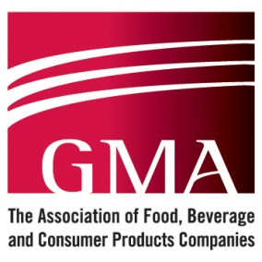

Advancing the 3rd Pillar
Develop Content
Capability-building Modules
Successful
Capability-
Building
Program
Trained
Regulators
Stakeholders
Improved
Food
Safety
Improved Regulatory
Structures & Harmonization
Increased Food
Safety Capability
Notes:
Here we tell the story of the APEC/FSCF/PTIN…
When it started
How it worked
What it delivered
Why it is so successful
It’s uniqueness
Why it serves as a spring-board for the larger World Bank-supported program.
What companies have been involved?

Slide 12
Benefits of Global Food Safety Capacity Building to Industry
GMA companies rely on a global supply chain for safe ingredients and raw materials.
Improved supply chain management by growers, producers, distributors, and retailers means…
  preventing problems at the source
  fewer food safety incidents involving our products
  more suppliers we can confidently source from
  less cost to manage food safety incidents
  enhanced consumer trust in our products

Slide 13
Benefits of Global Food Safety Capacity Building to Industry
GMA companies rely on competent labs to keep ingredients and products moving across borders and to consumers.
Improved lab competency means appropriate and accurate testing methodologies are used. This means…
  Fewer products experiencing delayed product registration
  Faster customs clearance
  Less time and cost wasted on duplicative testing
  More time for products to be on shelf (critical for perishable products)
  Less wastage and destruction if spoilage occurs

Slide 14

How industry has been involved
Capacity Building Workshops
Risk Analysis Workshop (August 2009)
Export Certification Workshop (February 2010)
Supply Chain Management Workshop (November 2010)
Incident Management Workshop (May 2011) training events
Improving lab capacity
Delivered a major workshop for managers of national laboratories and senior-level regulators and officials overseeing laboratories (August 2011)
Providing expertise to inform future areas of focus

Slide 15
Thank you for your time!
Contact Information:
Shannon Cole, MS, PMP
Senior Director, Science Program Management
Grocery Manufacturers Association
(202) 639-5979
scole@gmaonline.org

